Slide 1

Netflix Data Analysis Project 2025
This project explores a Netflix movies and TV shows dataset to understand content trends, audience preferences, and release patterns in 2025. The analysis focuses on genres, popularity, and yearly production to identify which types of content perform best and which years have the highest volume of releases.
Tech Stack & Skills
Exploratory Data Analysis (EDA) on movie dataset using Python, Pandas, NumPy, Matplotlib, Seaborn.
Data Cleaning: date parsing, NaN removal, genre explosion. Data Transformation: custom pd.cut() categorization, memory-optimized dtypes.
By- Sanyogita Rajput

Slide 2
Objective & Research Questions
Primary Objective: To understand genre distribution, audience preferences, and temporal patterns in movie production and popularity within the dataset.
Research Questions:
Q1: Which genre appears most frequently in the dataset?
Q2: Which genres receive the highest proportion of popular votes?
Q3: Which film achieved the highest popularity rating, and what genres does it represent?
Q4: Which film received the lowest popularity rating, and what genres characterize it?
Q5: In which year was the maximum number of films released?

Slide 3
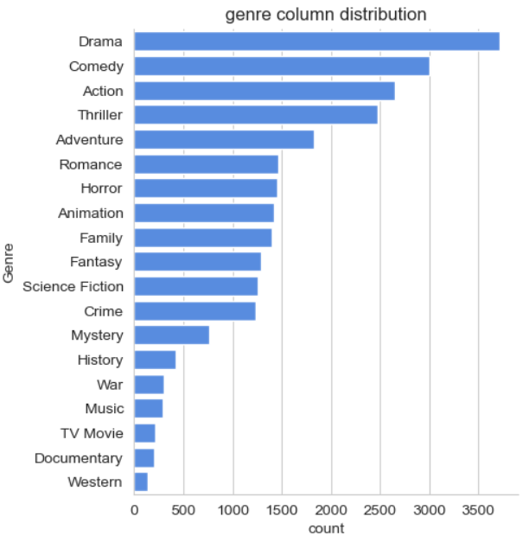
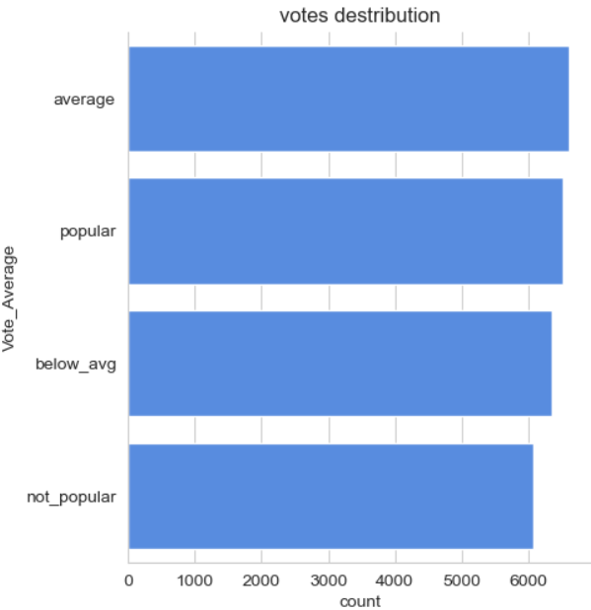
Q1: Most Frequent Genre
Finding: The Drama genre is the predominant category in the dataset, accounting for 14% of all films across 19 distinct genres.
Implication: Drama's dominance suggests a significant industry focus on character-driven narratives and emotional storytelling. This reflects both audience demand and production capacity in the drama segment.
Q2: Genres with Highest Popular Vote Representation
Finding: Approximately 25.5% of the dataset (6,520 films) received popular vote classifications. Among popular-vote movies, Drama maintains leadership with 18.5% of all popular-vote films, demonstrating consistent audience engagement.
Implication: The concentration of popular votes in Drama indicates strong audience reception and sustained interest in this genre category. This suggests that Drama films not only represent the largest volume but also maintain highest engagement metrics.

Slide 4
Q3: Highest Popularity Film & Genre Classification
Finding: "Spider-Man: No Way Home" achieved the maximum popularity rating in the dataset. This film spans three genres: Action, Adventure, and Science Fiction.
Implication: The convergence of Action, Adventure, and Science Fiction demonstrates successful multi-genre appeal, suggesting that hybrid genre combinations attract broader audience demographics and generate higher engagement levels.
Q4: Lowest Popularity Film & Genre Classification
Finding: "The United States, Thread" recorded the lowest popularity rating. This film is classified across five genres: Music, Drama, War, Science Fiction, and History.
Implication: Despite multi-genre positioning, films with dispersed genre classifications may struggle to establish clear audience identity. The complexity of five-genre alignment could dilute marketing effectiveness and audience targeting.

Slide 5
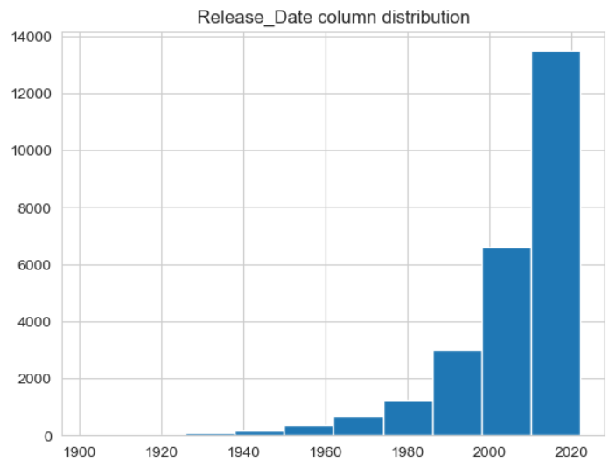
Q5: Year with Highest Film Production
Finding: 2020 recorded the maximum number of film releases in the dataset, indicating peak production activity during this year.
Implication: The concentration of releases in 2020 reflects industry trends, potentially influenced by streaming platform expansion, technological accessibility, and pandemic-related production dynamics. This year represents a significant inflection point in content volume.
Conclusion
This analysis reveals that Drama genre dominance is consistent across volume, popularity, and engagement metrics. The dataset demonstrates that single-genre or dual-genre positioning (exemplified by Spider-Man's Action-Adventure-Sci-Fi combination) outperforms heavily multi-genre classifications in popularity ratings. The 2020 production peak suggests accelerating content creation trends in the film industry, likely driven by digital distribution evolution and changing consumption patterns.

